Slide 1

STEC VEC Ammonia Load Project (25RPG012)
Project Overview for ERCOT RPG
July 29, 2025

Slide 2
Project Overview
The proposed project aims to support a new 300 MW Ammonia Plant Load in STEC’s load serving territory.
Proposed load located in Victoria County and expected to connect to a new 138kV load serving station named VBC.
The interconnection study for the proposed load has identified transmission system reliability criteria violations per Section 4 of the ERCOT Planning Guide (EPG).
STEC evaluated five (5) transmission system improvement options to address reliability issues and support regional demand.
Based on the analysis performed, STEC identified Option 5 as the preferred option
Tier 2 project estimated to cost $65.47 million with an in-service date of June, 2028
STEC has coordinated the option and the upgrades comprising the option with AEP

Slide 3
Project Overview
Option 5, the preferred option, is comprised of the following transmission system improvements
Build a new 138kV, 4-terminal load serving station named Bobcat
Build a 3.4-mile double circuit 138kV line from the VBC station to AEP’s existing 138kV DuPont switching station
Add a 138kV terminals at AEP’s Dupont switching station
Rebuild AEP’s 7.66-mile 138 kV Victoria Plant – Shepley – Dupont line with normal and 2-hour ratings of 485 MVA.
Rebuild AEP’s 7.66-mile 138 kV Victoria Plant – Dupont ckt2 with normal and emergency ratings of 485 MVA.
Remove the double circuit section of the Victoria Plant to Shepley and Victoria Plant to Dupont circuits (by rebuilding the two circuits on separate structures) to eliminate the NERC P7/ERCOT_1 (common tower outage) events.
This would require a new ROW and CCN.
Rebuild AEP’s 2.41-mile 138 kV Formosa – Joslin line with normal and emergency ratings of 485 MVA
Rebuild AEP’s 21.11-mile 138 kV Tungsten – Vistron – Black Bayou – Big Three – Dupont line with normal and emergency ratings of 485 MVA.

Slide 4
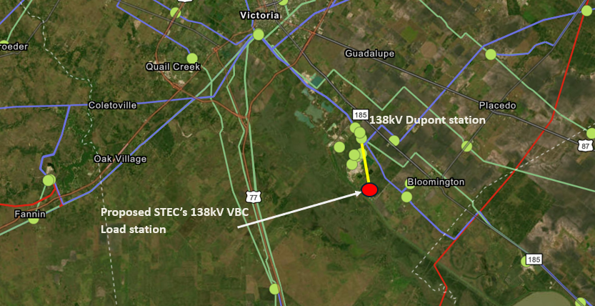
Proposed Project Location

Slide 5
Project Need
Address the violations under NERC and EPG criteria contingencies and ensure reliable integration of the proposed 300 MW Load
Violations observed in the initial steady state assessment include
P3 and EPG section 4.1.1.2(c) contingency event violations observed in summer peak (SP) conditions
P3, P7, EPG section 4.1.1.2(c) and EPG section 4.1.1.8 contingency event violations observed in High Renewable Minimum Load (HRML) (off-peak) conditions
Based on the results of STEC’s assessment, the facility loading violations/low voltage issues on the following transmission system facilities will need to be mitigated :
138 kV Formosa – Joslin line
138 kV Formosa – Lolita line
138 kV Victoria Plant – Shepley – Dupont line section
138 kV Dupont – Victoria Plant line
138 kV Dupont – Big Three – Black Bayou – Vistron – Tungsten line section
138 kV Tungsten – Greenlake – Weaver Road line
Low voltage issues on the 69 kV and 138kV stations in the vicinity of the proposed load

Slide 6
Study Methodology Overview
ERCOT 2024 Steady State Working Group (SSWG) 2028SP and 2028HRML cases are utilized for assessment
Incremental topology changes are incorporated to derive the study cases for the assessment:
All off-cycle IDEVs that have been posted to the ERCOT MIS after the release date of the starting cases were applied.
Any resources in the study area that met Section 6.9(1) requirements of the ERCOT Planning Guide not already modeled in the cases.
Large loads in the vicinity were modeled to develop the cases prior to adding the proposed load, per ERCOT LLI team’s input
Reliability assessment was performed for the cases outlined above under the following conditions:​
P0 (normal operating conditions)
P1, P2.1 and P7 contingency conditions
G-1 + N-1 contingency conditions
X-1 + N-1 (including P7) conditions around the loss of relevant 345/138kV auto transformers in the study area.
Select set of N-1-1 (P1+P1) for Summer Peak and N-1-1 (including P1+P1, P1+P7 and P7+P7) contingency conditions for HRML condition.

Slide 7
Study Results Summary
Summary of EPG/NERC reliability criteria violations, 300 MW Ammonia Plant Load (Victoria County, Texas)
Contingency Category | Case | Thermal Overloads (Exhibiting loading >100% of the 2-hr Emergency rating) | Voltage Violations | Unsolved Power Flow
EPG section 4.1.1.2(c) | SP | 138 kV Formosa – Joslin 138 kV Big Three – Black Bayou – Vistron – Tungsten line section | Multiple | None
P3 (EPG section 4.1.1.2(c)) | SP | 138 kV Victoria Plant – Shepley 138 kV Victoria Plant – Dupont | None | None
P3 (EPG section 4.1.1.2(c)) | HRML | 138 kV Victoria Plant – Dupont | None | None
EPG section 4.1.1.2(c) | HRML | 138 kV Formosa – Lolita 138 kV Tungsten – Greenlake – Weaver Road | Multiple | None
EPG section 4.1.1.8 | HRML | 138 kV Formosa – Joslin 138 kV Victoria Plant – Shepley – Dupont 138 kV Dupont – Big Three – Black Bayou – Vistron – Tungsten line section | Multiple | None

Slide 8
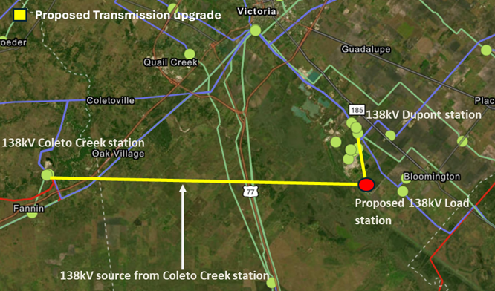
Option 1 – Coleto Creek 138kV Source
Build a new 138kV load serving station (VBC)
Build a 3.4-mile 138kV line from STEC’s VBC station to AEP’s 138kV DuPont station
Adding a terminal at AEP’s Dupont Switch Station to establish a new 138 kV connection to the STEC VBC 138 kV station.
Construct approximately 19.55-mile of new 138 kV transmission line from AEP’s Coleto Creek Station to the proposed STEC-owned 138 kV Load station.
The line will have normal and emergency ratings of at least 427 MVA and 478 MVA, respectively.
The line segment requires both CCN and ROW acquisition.

Slide 9
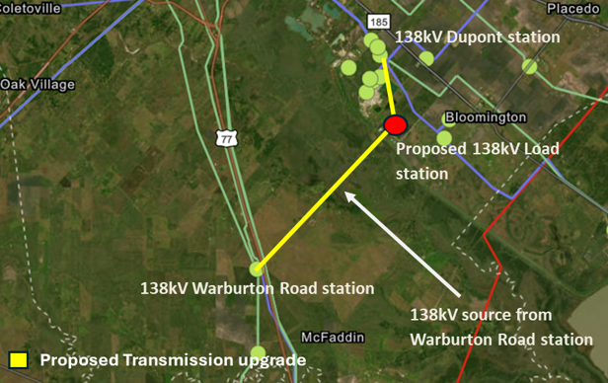
Option 2 – Warburton Road 138kV Source
Build a new 138kV 4-terminal load serving station (VBC)
Build a 3.4-mile 138kV line from STEC’s VBC station to AEP’s 138kV DuPont station
Adding a terminal at AEP’s Dupont Switch Station to establish a new 138 kV connection to the STEC VBC 138 kV station.
Construct approximately 10.35-mile of new 138 kV transmission line from STEC’s Warburton Road Station to the proposed STEC-owned 138 kV Load station.
The new line segment will have normal and emergency ratings of at least 427 MVA and 478 MVA, respectively.
The new line requires both CCN and ROW acquisition.

Slide 10
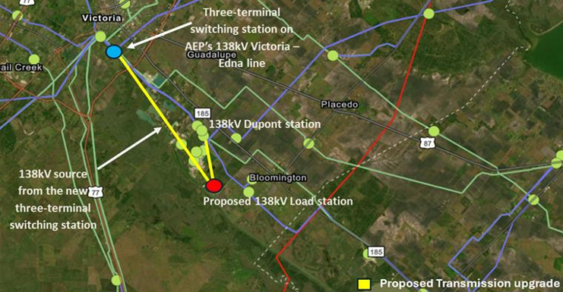
Option 3 – Victoria – Edna 138kV Source
Build a new 138kV 4-terminal load serving station (VBC)
Build a 3.4-mile 138kV line from STEC’s VBC station to AEP’s 138kV DuPont station
Adding a terminal at AEP’s Dupont Switch Station to establish a new 138 kV connection to the STEC VBC 138 kV station.
Construct a new 3-terminal switching station in AEP’s Victoria – Edna 138 kV line approximately 1 mile from Victoria.
Construct approximately 8.05-mile of new 138 kV transmission line from the new 3-terminal switching station to the proposed STEC-owned 138 kV Load station.
The new line segment requires both CCN and ROW acquisition.
The new line will have normal and emergency ratings of at least 427 MVA and 478 MVA, respectively.

Slide 11
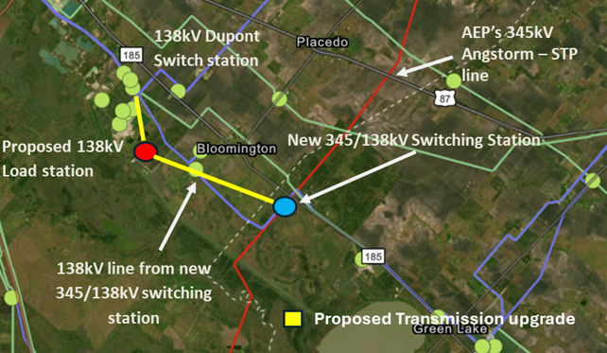
Option 4 – Angstrom – STP 345kV Source
Build a new 138kV 4-terminal load serving station (VBC)
Build a 3.4-mile 138kV line from STEC’s VBC station to AEP’s 138kV DuPont station
Adding a terminal at AEP’s Dupont Switch Station to establish a new 138 kV connection to the STEC VBC 138 kV station.
Tap AEP’s 345 kV Angstrom – STP transmission line approximately 54.6 miles from Angstrom through a new 345/138 kV auto station.
Install two (2) 345/138 kV autotransformers at the new 345/138 kV station.
Construct approximately 8-mile of new 138 kV transmission line from the new 345/138 kV auto station to the proposed STEC-owned 138 kV Load station.
The new line segment requires both CCN and ROW acquisition.
The new line will have normal and emergency ratings of at least 427 MVA and 478 MVA, respectively.

Slide 12
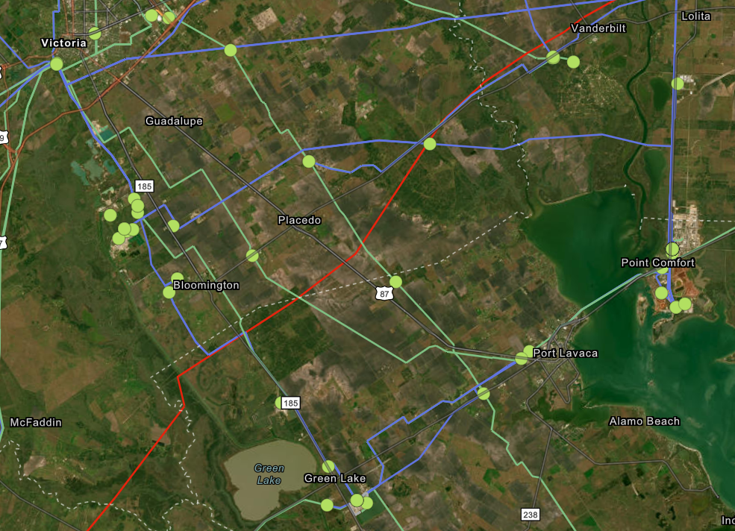
Option 5 – Rebuilding Existing Infrastructure
Build a new 138kV 4-terminal load serving station (VBC)
Build a 3.4-mile 138kV line from STEC’s VBC station to AEP’s 138kV DuPont station
Adding a terminal at AEP’s Dupont Switch Station to establish a new 138 kV connection to the STEC VBC 138 kV station.
Rebuild AEP’s 7.66-mile 138 kV Victoria Plant – Shepley – Dupont line with normal and emergency ratings of 485 MVA.
Rebuild AEP’s 7.66-mile 138 kV Victoria Plant – Dupont ckt2 with normal and emergency ratings of 485 MVA.
Remove the double circuit section of the Victoria Plant to Shepley and Victoria Plant to Dupont circuits (by rebuilding the two circuits on separate structures) to eliminate the NERC P7/ERCOT_1 (common tower outage) events. This would require a new ROW and CCN.
Rebuild AEP’s 2.41-mile 138 kV Formosa – Joslin line with normal and emergency ratings of 485 MVA
Rebuild AEP’s 21.11-mile 138 kV Tungsten – Vistron – Black Bayou – Big Three – Dupont line with normal and emergency ratings of 485 MVA.
Proposed 138kV Load station
Proposed new transmission line
Rebuilding existing line section

Slide 13
Option Performance Evaluation
STEC performed steady state assessments for the transmission enhancements options to mitigate the violations under NERC and EPG contingencies.
A summary of performances of Options 1 through 5 is provided below
Option | Addresses all thermal overloads per EPG requirements after load | Incremental Reliability Issues Observed | Voltage Security issues | Requires CCN | Preferred
1 | No | No | Yes | Yes | No
2 | No | Yes | Yes | Yes | No
3 | No | No | Yes | Yes | No
4 | No | No | Yes | Yes | No
5 | Yes | No | No | Yes | Yes

Slide 14
Option Performance Summary
Options 1, 3, and 4 do not resolve all EPG reliability violations
These options still need transmission upgrades outlined in Option 5 for reliably integrating the proposed 300 MW load.
Additionally, these options are expected to require VAR support to address local low voltage violations.
Option 2 has similar deficiencies as Option 1, 3 and 4.
Additionally, STEC observed new thermal overloads during summer peak and off-peak conditions for this option.
Option 5 adequately addresses all EPG violations for the conditions studied.
Mitigates all the thermal overloads and low voltage concerns observed under NERC and EPG criteria events for the conditions studied
No incremental issues observed
Most cost-effective solution.
Reliably integrates the proposed 300 MW load
Requires the least amount new greenfield transmission construction

Slide 15
Stability Assessment – Option 5
STEC utilized the ERCOT DWG 2024 flat start 2026 SP and 2027 HRML cases as the starting point of the stability analysis conducted for the study
STEC adopted assumptions consistent with the steady-state analysis to develop the stability study cases.
STEC assessed the impact of the proposed load and incremental implementation of Option 5 on system stability, including:
Transient rotor angle stability
Voltage stability
The analysis focused on nearby transmission system performance under NERC and ERCOT planning guide events.
No transmission system stability concerns identified under any events with proposed 300 MW load and transmission improvements included in Option 5

Slide 16
Short Circuit & SSR Assessment – Option 5
Short Circuit Assessment
STEC utilized the ERCOT System Protection Working Group (SPWG) 2028 FY case as the starting point of the short circuit analysis
STEC adopted assumptions consistent with the steady-state analysis to develop the short circuit study cases.
Fault duties were evaluated with and without the proposed load and transmission improvements comprising Option 5.
No fault duty exceedances were observed for any evaluated transmission breakers owned by STEC or AEP in the study area.
Subsynchronous Resonance (SSR) Screening Assessment
The proposed transmission improvements associated with Option 5 do not result in any material topological changes except for the addition of the new 138kV radial line from STEC’s VBC station to AEP’s 138kV DuPont station.
Therefore, the addition of the recommended option is not expected to have any material impact in terms of SSR risk for existing and/or planned generation resources.

Slide 17
Summary and Recommendation
Based on the reliability study results, Option 5 is the most cost-effective and technically viable solution and therefore is STEC’s preferred option.
It addresses all reliability concerns and supports the integration of the proposed Ammonia Plant Load at its full capacity (300 MW)
Short circuit and stability assessments did not indicate any concerns with the addition of the proposed load and the transmission improvements associated with the preferred option (Option 5).
The preferred Option 5 will require a CCN application and is classified as a Tier 2 project
Estimated cost for Option 5 is $65.47 million and target completion date is June 2028

Slide 18
Questions?
Thank You!

